Slide 1
Unit 4
Teacher: iddo sadeh

Slide 2
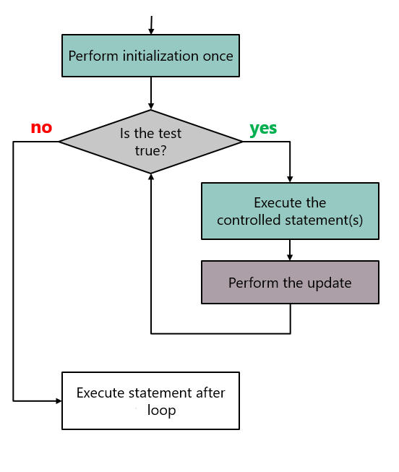
Iteration (loops)
*taken from CSAwesome textbook

Slide 3
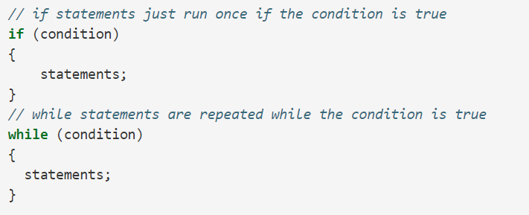
While loops
*taken from CSAwesome textbook

Slide 4
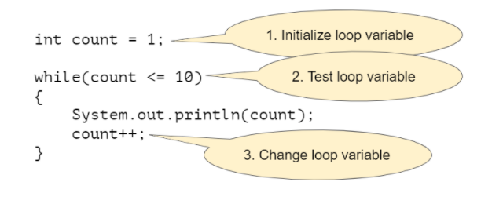
Counter controlled while loops
*taken from CSAwesome textbook
Notes:
Question 1

Slide 5
Tracing tables
https://www.youtube.com/watch?v=TZss5ukwN8s&t=1s
Notes:
Question 2

Slide 6
Common errors
Infinite loops
Off-by-one loop

Slide 7
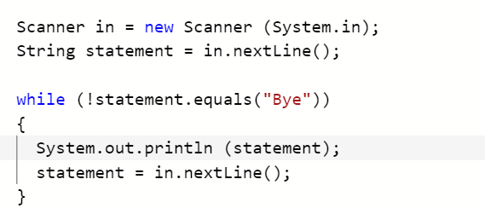
Input controlled while loops
Most common and correct use of a while loop
*taken from CSAwesome textbook
Notes:
Question 3 and 4

Slide 8
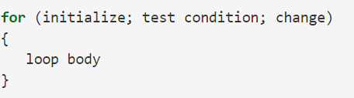
For loops
Commonly used for as a counter-controlled loop
Initialize, test condition and change are optional, ; are not optional

Slide 9
There are three parts in a for loop header: the initialization, the test condition (a Boolean expression), and an increment or decrement statement to change the loop control variable.
In a for loop, the initialization statement is only executed once before the evaluation of the test Boolean expression. The variable being initialized is referred to as a loop control variable.
In each iteration of a for loop, the increment or decrement statement is executed after the entire loop body is executed and before the Boolean expression is evaluated again.
A for loop can be rewritten into an equivalent while loop and vice versa
*taken from CSAwesome textbook
Notes:
Question 5

Slide 10
Loops and strings
Loops can be used to traverse or process a string.
There are standard algorithms that utilize String traversals to:
Find if one or more substrings has a particular property
Determine the number of substrings that meet specific criteria
Create a new string with the characters reversed
*taken from CSAwesome textbook

Slide 11
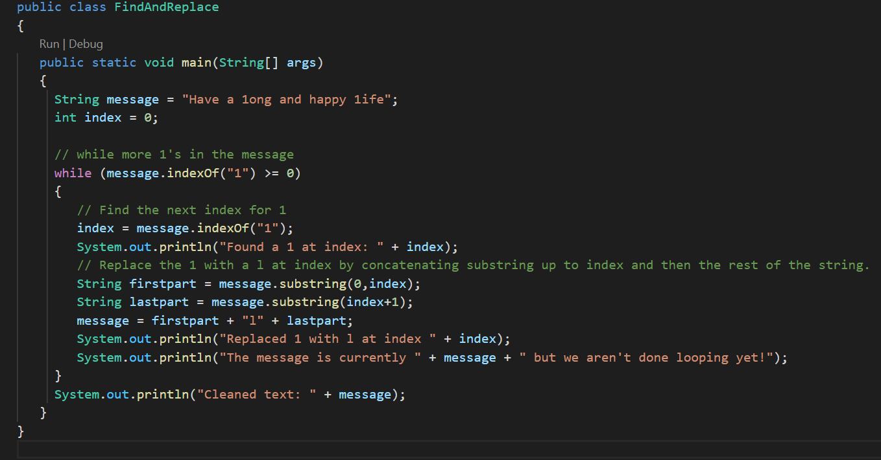
Find and replace loop

Slide 12
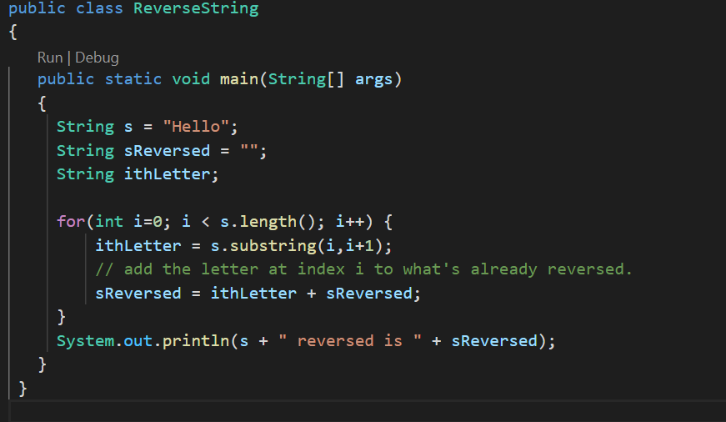
Reversing strings with loops

Slide 13
Nested for loops
Nested iteration statements are iteration statements that appear in the body of another iteration statement.
When a loop is nested inside another loop, the inner loop must complete all its iterations before the outer loop can continue.
*taken from CSAwesome textbook

Slide 14
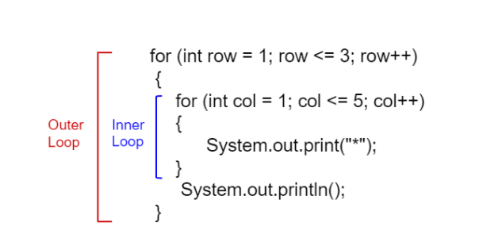
*taken from CSAwesome textbook

